Slide 1



IPv6 Readiness of Server
ICT333-Information Technology Project
Presented by IT08

Slide 2
OVERVIEW
Background
Solution: IPv6 Vs. IPv4 performance
Demonstration of Software
Constraints
Current Status
Conclusion
Notes:
Correction: Don’t talk about the background in the overview

Slide 3
INTERNET PROTOCOL (IP)
Core network layer protocol
What is an Internet Protocol Address?
Is a unique string of numbers
That uniquely identify internet devices
Notes:
Is a unique string of numbers separated by full stops that identifies each computer using the internet
Core network layer protocol upon which the internet is built upon

Slide 4
INTERNET PROTOCOL VERSION 4 (IPV4)
Been in use since the origin of the internet
Address length is 32 bit
All ipv4 addresses depleted
What’s next? We need a mechanism to support the explosion of current devices
IPv6
Notes:
-Current version of the protocol IP version four has Been in use since the origin of the internet
-The growth of IP address demand and IPv4 exhaustion is also expected to come from new applications and innovations, including always-on appliances used in utility grids, smart homes, health care monitoring and intelligent sensor network

Slide 5
INTERNET PROTOCOL VERSION 6 (IPV6)
Most recent version of the internet protocol
Increases address length
IPv6 – ability to give one item on the planet an address
IPv6 – has been in existence for while but only recently has the deployment been undertaken on a large scale
IPv6 address space is vast enough to allocate an address to the following devices: TV, fridge, microwave, radio, etc..
Notes:
IPv6 address space is vast enough to allocate an address to the following devices: TV, fridge, microwave, radio, etc.. Caution: slides need to be reduce

Slide 6
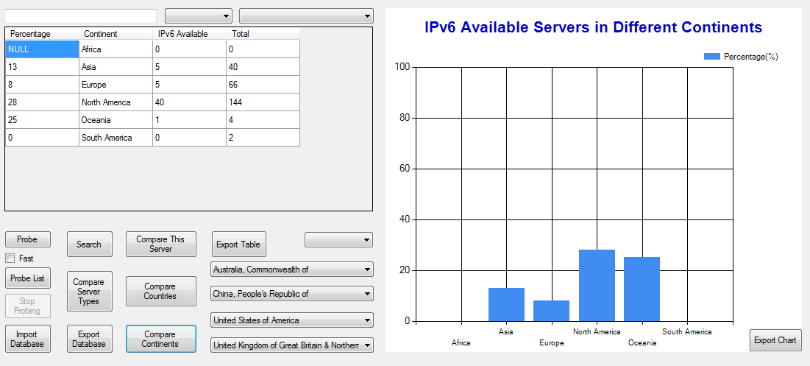
BACKGROUND
How much of the Internet Infrastructure is IPv6 ready ?
Notes:
Recommendations: Remove the graphic. (more text than picture, not catchy) Fixed
What’s the performance of ipv4 vs ipv6
Art of research at the moment

Slide 7
BACKGROUND
IPv4 already depleted
Transition to IPv6 presents an opportunity
Virtually unlimited addresses
Notes:
Background: Work on a Joint research project. Purpose: Work on the transition of IPV4-IPV6 project
A single slide: demonstrating what an ip address is.
Explicitly write ip version instead of (IPv4) (one slide IPv4)
One slide (ipv6)- more addresses; tv, radio, microwave can have an address with v6
Single: number of servers that are currently ipv6 (world wide)
(Sebastian recommend to such a graph of what remains of IPv4) worldwide

Slide 8
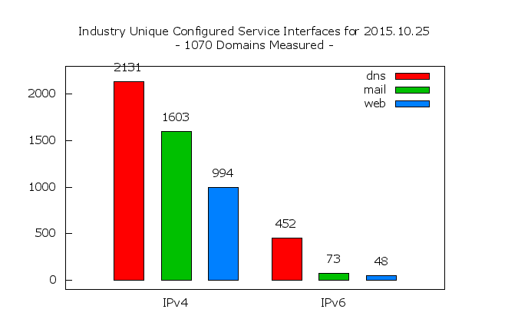
BACKGROUND
Photo acquired from - http://fedv6-deployment.antd.nist.gov/cgi-bin/generate-com
Notes:
The era of freely available IPv4 addresses has come to an end as Regional Internet registries are now assigning their last few remaining IPv4 addresses. Many of the largest mobile and broadband networks in the world are actively rolling out IPv6 connectivity to their end-users
Internet Protocol (IP) is the core network-layer protocol upon which the Internet is built. The current version of the protocol, IPv4, has been in use since the origin of the Internet. IPv6 (formerly known as IPng or IP next generation) is the version designed to succeed IPv4. IPv4 exhaustion and IPv6 adoption are important Internet issues, in addition to overall Internet penetration.
The era of freely available IPv4 addresses has come to an end as Regional Internet registries are now assigning their last few remaining IPv4 addresses. Many of the largest mobile and broadband networks in the world are actively rolling out IPv6 connectivity to their end-users
Internet Protocol (IP) is the core network-layer protocol upon which the Internet is built. The current version of the protocol, IPv4, has been in use since the origin of the Internet. IPv6 (formerly known as IPng or IP next generation) is the version designed to succeed IPv4. IPv4 exhaustion and IPv6 adoption are important Internet issues, in addition to overall Internet penetration.

Slide 9
SOLUTION
Software Functions
Probing ipv4/ipv6 available servers
Automatic & manual probing
Comparing network latency statistics
Gather statistic stored (Database storage)
Comparison of continents, countries
Notes:
Feedback. Figure out what you want to say. Practice, practice. If you’re using a paper, don’t read from it, only use it as a reference point.
Focus more on the prototype functions; What data are you collecting and what and how are you measuring. The slide must start with key functions.
Mention services services that your software is probing

Slide 10
Methodology
Methodology – Rapid prototyping methodology
Communications Management – Weekly Reporting methods
Time Management - Used task list
Notes:
What’s the key point of rapid prototyping,
Design, implement, re-design and implement. Explain the process. Why does it make sense
Iterative process

Slide 11
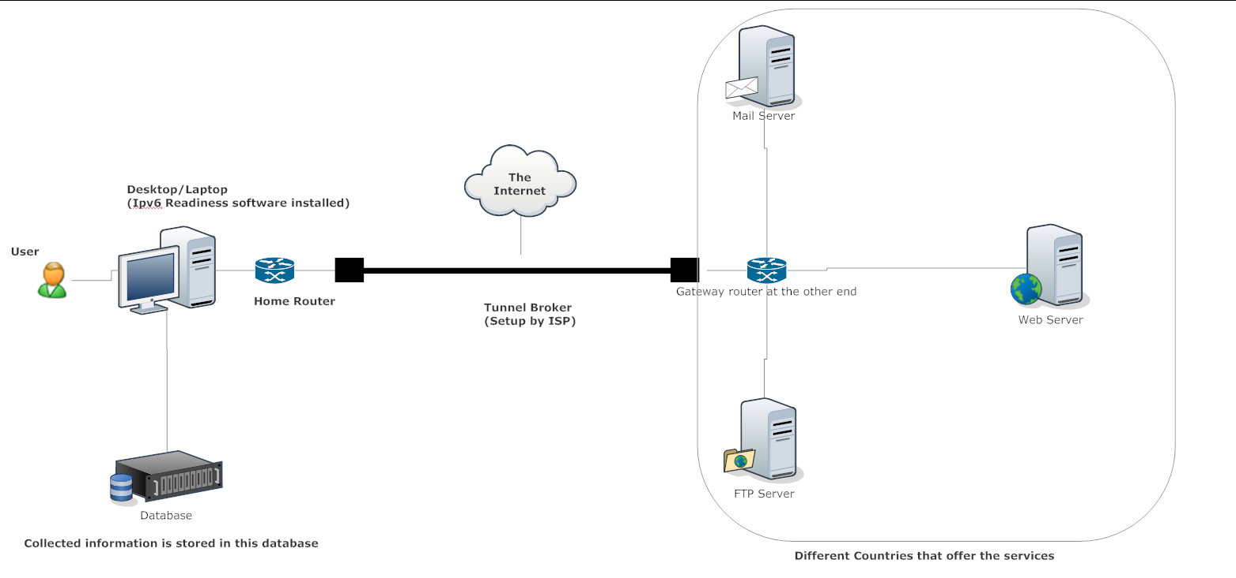
SOLUTION
Mail Server
Desktop/Laptop (Software Installed)
User
Home Router
Tunnel Broker (Setup by ISP)
Gateway router at the other end
Web Server
FTP Server
Database
Collected Information Stored into database
Different Services Offered
Notes:
IPv4 cloud & ipv6 cloud:
Developed a software using C# and xammp
Tunnel Broker
Uninstall XAMMP if it was already installed
Make sure antivirus does not block the IPAlog.txt file

Slide 12
Demonstration
Functions
Representation
Search
Probing
Notes:
Feedback. Have one slide that explains what you’re going to demonstrate. (at an abstract level explain up front what you’re about to demonstrate)
The second slide should be follow by the demonstration
Explain the structure of the GUI;

Slide 13

Constraints
Slow speed in massive probing
Only XAMPP MySQL database is supported
Supports only four probing methods
Only available on Windows platform

Slide 14
Current status
All requirements have been fulfilled
Accepted by client
Additional functions
Automatic database connection
Database import & export
Tables & charts export
Future improvement
Statistical measurement

Slide 15
CONCLUSION
Functionalities Achieved
Probing
Processing and storage of data
Comparison of Statistics
Import and Export Database
Export Charts and tables
Large scale probing
Notes:
Summarize what the project has achieved.
Explained further what probing is

Slide 16
Thank You !!
We would like to thank our Client/Supervisor Dr.Sebastian Zander and Lecturer Peter Cole for your support.
Lastly, we would like to extend our appreciation to all the attendees for your time.

Slide 17
TEAM MEMBERS
ICT333-Information Technology Project
Abdul - abdulsami_91@hotmail.co.uk
Bilawal - bilawalmushtaq@gmail.com
Leslie - leslievundu@gmail.com
Man Fu - george10282006@hotmail.com
Robert - bobwinbw@yahoo.fr

